Slide 1

Administering ED Grants:
A risk-based approach to establishing strong internal controls to ensure successful project outcomes and fiscal accountability
Grants Policy & Training Division
Office of Finance and Operations

Slide 2
Agenda
Identify key resources
Highlight Ed and federal-wide grant policies
Understand the importance of internal controls and review best practices
Evaluate strengths and weaknesses of existing internal control practices and procedures
Develop internal control practices and procedures that help ensure grant management consistency despite change in SEA or local government leadership
Ensuring successful project outcomes

Slide 3
Partnership Forged in Collective Stewardship
ED staff and grantees work together to ensure:
  Successful project outcomes
  Compliance with all statutes, regulations, terms and conditions of the grant awards
  Proper stewardship of taxpayer funds
  Accountability for project success

Slide 4


ED Staff Responsibilities
Monitor programmatic and financial performance
Provide technical assistance
Implement necessary approvals, specific conditions, risk mitigation strategies as warranted
Utilize G5
Determine annual substantial progress
Report project-specific findings to other ED offices
Make continuation awards
Close out grant awards

Slide 5
Grantee Responsibilities
Ensure and document programmatic success
Ensure and document financial accountability
Maintain records and, if applicable, monitor subgrantee performance
Comply with terms and conditions listed on the Grant Award Notification (GAN)
Submit required reports in timely fashion
Establish and follow strong internal controls

Slide 6

Subrecipient Monitoring
ED is responsible for monitoring its grantees who in turn monitor their subrecipients (also referred to as subgrantees)
Grantees evaluate the risk of subgrantees to mitigate potential pitfalls
Subgrantees who meet the single audit threshold are required to undergo the audit
Grantee then needs to obtain the audit report and issue management decisions for any specific findings

Slide 7
Tools of the Trade
Program statute
Regulations
Executive orders
Title 34 of the Code of Federal Regulations (CFR) Education Department General Administrative Regulations (EDGAR)
Title 2 of the CFR, Grants and Agreements
Grant Award Notification (GAN)
  See accompanying attachments
Approved application
G5

Slide 8
EDGAR
Education Department General Administrative Regulations, Title 34
http://www2.ed.gov/policy/fund/reg/edgarReg/edgar.html
Grant and cooperative agreement programs are located at Title 34 of the Code of Federal Regulations (CFR); Parts 75, 76, 77, 79, 81, 82, 85, 97, 98, and 99
Suspension and Debarment Regulations are located at 2 CFR Part 180
Notes:
Part 75—DIRECT GRANT PROGRAMS
Part 76—STATE-ADMINISTERED PROGRAMS
Part 77—DEFINITIONS
Part 79—INTERGOVERNMENTAL REVIEW
Part 81—GENERAL EDUCATION PROVISIONS ACT ENFORCEMENT
Part 82—LOBBYING
Part 84—DRUG-FREE WORKPLACE
Part 86—DRUG AND ALCOHOL ABUSE PREVENTION
Part 97—PROTECTION OF HUMAN SUBJECTS
Part 98—STUDENT RIGHTS IN RESEARCH, EXPERIMENTAL PROGRAMS, AND TESTING (current version)
Part 99—FAMILY EDUCATIONAL RIGHTS AND PRIVACY

Slide 9
Updated 2 CFR Part 200 In the Works
OMB is working to reissued the Uniform Guidance in 2023
  Goal is to publish new 2 CFR 200 in December 20023 that:
  Reflects administration priorities and any statutory requirements
  Clarify 2 CFR language and regulatory interpretations to ensure consistency between agencies
  Consider policy changes recommended by agencies and external stakeholders

Slide 10
2 CFR 200 Table of Contents
Uniform Guidance
Subpart A – Acronyms and Definitions
Subpart B – General Provisions
Subpart C – Pre-Award Requirements
Subpart D – Post-Award Requirements
Subpart E – Cost Principles*
Subpart F – Audit Requirements
Appendices III-V and VII – Indirect Cost/Cost
Allocation Plans
Appendix XI – Compliance Supplement
Ecfr.gov

Slide 11

Post Award Key Changes
Increased flexibilities and responsibilities for you, our grantees:
Greater emphasis on internal controls to ensure compliance and fiscal responsibility
Enhanced oversight requirements of sub-recipients and contracts which include risk assessment and use of monitoring tools
Greater focus on performance expectations and results

Slide 12


Monetary Road Map
Clear, concise, and detailed
Consistent with institutional policy
Meets federal requirements
Aligned with GPRA
Revised within scope of project
Achieve project goals

Slide 13
Budgetary Questions
Are the activities and or expenditures…
Allowable – permitted or not specifically prohibited
Allocable – necessary for project’s success
Reasonable – costs incurred by a “prudent” person

Slide 14
Risk Assessment
2 CFR Part 200.206 requires all Federal agencies to conduct a risk assessment prior to making awards (applies to new, non-competing continuations and supplements)
Evidence of this competency includes:
  Financial Stability
  Previous experience with Federal awards
  Adequate internal, fiscal, and administrative controls
ED must assess grantee risk as grantees assess the risk of subrecipients
Notes:
ED was conducting risk assessments for discretionary grant awards since 2011 and we as an agency have been ahead of the curve.

Slide 15


Defining Risk
Risk is a measure of the potential inability to achieve overall program objectives within defined requirements related to cost, schedule, legislative authority and grant management practice
Materiality
Complexity
History
Propensity

Slide 16
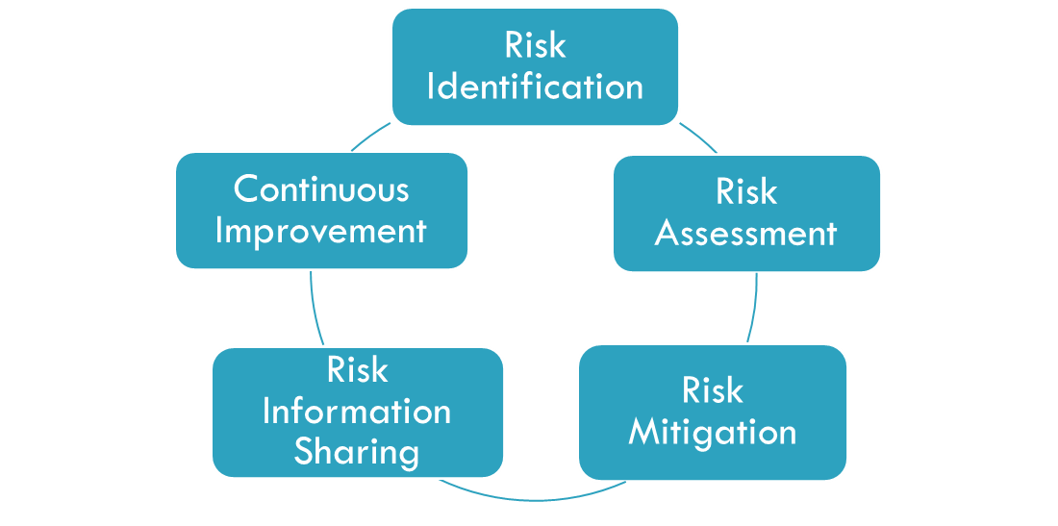
Cycle of Assessing Risk

Slide 17

What Risks Impact You?

Slide 18
Risk Assessment Impact
If ED determines there is sufficient evidence of problems, one or more of the following actions will occur:
Impose specific conditions on the award to protect the Federal interest
Designate the applicant as “high risk” (2 CFR 3474.10)
Not make the award to protect taxpayer dollars

Slide 19
Imposing Specific Conditions
2 CFR Part 200.208 outlines types of conditions to impose on grantees to
  Improve performance
  Protect taxpayer dollars
Through ongoing monitoring, risks and problem areas can be identified and targeted at any time to improve grantee performance
Work with grantees to help them address problem areas and remove specific conditions
Notes:
(1) Requiring payments as reimbursements
rather than advance payments;
(2) Withholding authority to proceed
to the next phase until receipt of evidence
of acceptable performance within
a given period of performance;
(3) Requiring additional, more detailed
financial reports;
(4) Requiring additional project monitoring;
(5) Requiring the non-Federal entity
to obtain technical or management assistance;
or
(6) Establishing additional prior approvals.
(b) The Federal awarding agency or
pass-through entity must notify the
applicant or non-Federal entity as to:
(1) The nature of the additional requirements;
(2) The reason why the additional requirements
are being imposed;
(3) The nature of the action needed to
remove the additional requirement, if
applicable;
(4) The time allowed for completing
the actions if applicable, and
(5) The method for requesting reconsideration
of the additional requirements
imposed.
(c) Any special conditions must be
promptly removed once the conditions
that prompted them have been corrected.

Slide 20
Examples of Specific Conditions
Requiring payments as reimbursements rather than advance payments
Withholding authority to proceed to the next phase until receipt of evidence of acceptable performance within a given performance period
Requiring additional financial or project reporting
Requiring the non-Federal entity to obtain technical or management assistance
Establishing additional prior approvals

Slide 21
High-Risk Designation
Although the Uniform Guidance authorizes specific conditions to address risk, it does not use the term “high risk”
ED continues to use the high-risk designation under 2 CFR 3474.10
ED uses the standards in the Uniform Guidance to impose specific or high-risk conditions, as appropriate, on grants

Slide 22

Risk Mitigated

Slide 23
Single Audit Overview
See 2 CFR Part 200 Subpart F
Non-Federal audit if expending $750,000 or more annually in Federal funds
Questioned costs greater than $25,000 are no longer required to be reported
Review Attachment 3 of the GAN

Slide 24
Common Audit Findings
Missing time and effort reports
Poor record-keeping
Failure to obtain prior approval
Cost-share/matching
Incorrect indirect cost rates
Unallowable costs
Subrecipient monitoring
Lack of internal controls
Prioritize
Mitigate

Slide 25
200.303 Internal Controls
Is a process effected by an entity’s oversight body, management, and other personnel that provides reasonable assurance that the objectives of an entity will be achieved
These objectives can be broadly classified into the following three categories:
  Operations
  Reporting
  Compliance

Slide 26
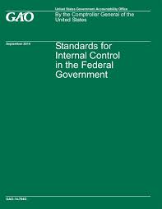
GAO’s Standards for Internal Controls
Standards to guide agency’s operations: GAO established these standards so that government agencies know:
  What internal control is (and isn’t)
  How it should work effectively within agencies
  How entities should use the Green Book
Resource not just for federal entities:
The Green Book may also be used and adopted by state & local government agencies, as well as non- profits
Management can determine how to appropriately apply the elements of within the Green Book to their particular agencies’ needs

Slide 27
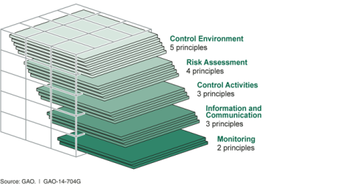
Internal Control Components

Slide 28
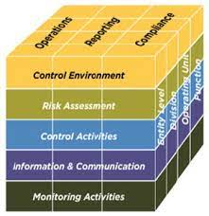
Levels of Organizational Structure
Let’s reconsider internal controls for your organization:
Entity Level
Division
Operational Unit
Function

Slide 29
Control Environment
Management demonstrates commitment to integrity and ethical values
Management/oversight body oversees the entity’s internal control system
Management establishes an organizational structure, assigns responsibilities and delegates authority to achieve the agency’s mission and objectives

Slide 30
Control Environment
Management demonstrates a commitment to recruit, train and retain competent people
Management evaluates performance and holds individuals accountable for their internal control responsibilities.

Slide 31
Discussion Question
How do maintain strong internal controls during staff transitions and turnover?

Slide 32
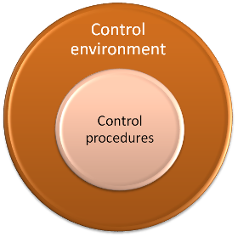
Control Environment Areas
Hiring Practices
Training Programs
Whistleblower Policies
Code of Ethics
Clear lines of responsibility and authority
Grants/program administration
Fiscal management and operations
Document Procedures

Slide 33
Risk Assessment Categories
Strategic Risk—political, talent and succession planning, dependence on other organizations
Financial Risk—audit findings and other things that would undermine reporting integrity
Compliance Risk—fraud, theft, embezzlement and/or noncompliance with regulations
Operational Risk—that programs may fail to meet their objectives, mishandle federal grant funds, natural disasters, lack of accessible technology, etc

Slide 34
Control Activities
Preventive—these controls help management to avoid problems before they occur. Prevent the occurrence of negative events
Detective—these controls help to uncover issues after they’ve occurred. Identify the occurrence of a negative event
Corrective—these controls detect if risk is present, and then elicits a response and/or corrective action

Slide 35
Control Activities Examples
Approvals and authorizations (Preventive)
Reconciliations (Detective)
Training (Preventive)
Update/Implement SOPs (Corrective and/or Preventive)
Asset Security (Preventive)
Segregation of Duties (Preventive)
Compensatory– employed when a weakness or limitation exists within the control environment

Slide 36
Control Activities Conversation
What control activities does your organization rely on the most currently?
What control activities would you like to implement within your organization?
What are the strengths and weaknesses of your existing internal controls?

Slide 37
Information and Communication
Management should use quality information to achieve the agency’s goals and objectives
Management should internally communicate the necessary quality information to achieve the entity’s objectives
Management should externally communicate the necessary information to achieve the agency’s mission and objectives

Slide 38
Monitoring
Activities management establishes to assess the quality of performance over time and to promptly resolve management reviews or audit findings
Management establishes and operates monitoring activities to assess the internal control system and evaluate results
Management remediates identified internal control deficiencies in a timely manner

Slide 39
Validating Controls
Deficiency in Design
  A critical control is not properly designed and does not meet the control objective, or is simply ineffective
Deficiency in Operations
  A critical control is designed properly but does not perform in the intended manner and is unable to address the identified risks
Monitor frequently for effectiveness
  Review supporting documentation
  Review reconciliations
  Review policies and procedures and observe demonstrations to ensure procedures are being followed properly
Document & Address
Deficiencies

Slide 40
Criteria
The auditors must identify what the grantee failed to do or did wrong
Below the grantee did not have procedures to ensure direct costs are necessary and reasonable in accordance with Uniform Guidance subpart E
Criteria: The charter school is required to have procedures in place to assure the direct costs of the grant are necessary and reasonable for the proper administration of the program
And allowable under the Uniform Guidance Subpart E. The school’s policy requires the employees’ direct supervisor is to review and approve all time cards.

Slide 41
Condition
Condition: Auditors must identify what they found wrong along with supporting facts.
Here auditors tested 40 disbursements and found three lacked proper approval by a supervisor.
Condition: Ten of the 40 disbursements tested for an ED grant were payroll disbursements. The timecards for three payroll disbursements lacked proper approval by the appropriate supervisor

Slide 42

Cause
It is critical that the cause behind the audit can be determined
What caused the finding?
What is the likelihood of a repeat?
Cause: Designed internal controls over payroll approval were not followed as required by the charter school’s policy

Slide 43
Effect
Consider the impact of the finding on successful project outcomes, compliance and fiscal accountability
ED staff and grantees should consider:
  How consequential are the findings to the successful completion of the grant project?
  Are the findings an indication larger issues?
Effect: Without properly designed internal controls over payroll approval, errors or omissions could occur affecting the accuracy of disbursements for the grant.

Slide 44

Recommendation
What the auditor thinks would mitigate or prevent a reoccurrence of the finding
Recommendation: We recommend that procedures be in place to ensure all timecards are reviewed and approved by the employees’ direct supervisors to ensure appropriate disbursement of payroll expenditures.

Slide 45

ED's Computer Based Training Courses
Internal Controls
Indirect Costs
Formula Grants Training
Discretionary Grants Training
Cash Management
Protection of Human Subjects in Research
Subrecipient Monitoring
Allowable Costs
Procurement
FFATA Reporting
More trainings on the way!

Slide 46

ED’s Chief Concerns
Project goals indicators not met
Excessive or infrequent drawdowns
Poor recordkeeping and fiscal accountability

Slide 47

Indicators of Success
Regular progress meeting goals and objectives
Good recordkeeping and fiscal accountability
Accurate, valid, reliable, reporting
Timeliness

Slide 48

Points to Consider
Document project activities and expenditures
Establish and implement an internal control system that complies with laws and requirements
Check grant terms, conditions and grant award attachments for possible exceptions
  Read the “Fine Print”
  Correctly cite the regulations
When in doubt, call your Program Officer

Slide 49
Thanks for joining us today!
Best wishes administering your
ED grants.
Grants Management Policy Division
Office of Finance and Operations

