Slide 1
Education Innovation and Research (EIR) Overview of the EIR FY 2021 Competition
Note: These slides are intended as guidance only. Please refer to the official Notices As they are published in the Federal Register.
Notes:
Welcome to the Education Innovation and Research Program FY 2021 Competition overview webinar.
These informational slides are meant to introduce you to the Education Innovation and Research (EIR) Program and will provide you with a general overview of the EIR program’s purposes, its funding structure, and the EIR grant competitions for FY2021. This will include a status update for the EIR competitions. The goal is to help you better understand the program and what you need to know to prepare a successful application.
If you are planning to apply to EIR, you should read carefully the specific notice inviting applications (NIA) and the specific application package for the competition to which you are applying. These slides are for information purposes only, and applicants should rely upon the NIA for the official competition requirements.

Slide 2
Introductions
Jamila Smith, Director of Innovation and Early Learning Programs (IELP)
Ashley Brizzo, EIR Group Leader
Yvonne Crockett, Competition Manager
Vicki Robinson, Program Officer
Ruben Vazquez, Program Officer
Notes:
We would like to take a moment for quick introductions. I am Jamila Smith, the Director for Innovation and Learning Programs. This is the division at the U.S. Department of Education that includes the EIR program.
Joining me today will be various leaders on the EIR team including Ashley Brizzo, Yvonne Crocket, Vicki Robinson and Ruben Vazquez.

Slide 3
Agenda
Introductions
Overview of EIR
General information about FY2021competitions
Updates on the funding priorities for FY2021
Review of available information and resources
Summary of key dates
Call for peer reviewers
Notes:
The agenda today will include the following topics:
Introductions
We’ll share the goals and general structure of the EIR program
Provide details about the Early-phase competition.
We will also share information about the FY2021 funding priorities
At the end of our time today, we hope you will also know where to find additional information and resources, as well as the key dates for current consideration
And if after the content we’ve provided, you decide not to submit a grant application this year, we’ll also provide information about being a peer reviewer.

Slide 4
Overview of EIR: Program Goals
Explore new ways of addressing persistent challenges that other educators can build upon
Sustain, replicate, and scale successful practices in new schools, districts, and States
Address the barriers to scale, such as cost structures and implementation fidelity
Build the evidence base on effective educational practices to improve achievement for high-need students.
Notes:
EIR continues to elevate innovation through three overall goals for the program, each of which corresponds to an important problem facing K-12 education in the United States.
This includes addressing persistent challenges, scaling successes (including addressing issues with replicating the program in the past), and building evidence on what works.
Important to note is that innovativeness of the project is key as this is not a program for well established, tried and true programs. The purpose of EIR is NOT to provide operational funding for those programs that are up and running and simply need an infusion of funds to continue implementing established education practices.
To continue the EIR investment the expectation is to continue the work after the federal grant, enable other to replicate it in other settings/populations, and expand the reach to additional districts/states.
In summary, all EIR projects should test out innovation and contribute to new knowledge to the field

Slide 5
OVERVIEW OF EIR: STRUCTURE
A Model Tiered Evidence Grant Program
 | Early-Phase | Mid-Phase | Expansion
Level of Innovation and Scale | Develops and tests innovative education practices | Refines innovative education practices at a regional or national scale | Scales innovative practices nationally
Evidence | Applicants must demonstrate a rationale based on high quality research findings of evaluation | Applicants must meet “Moderate Evidence” standard | Applicants must meet “Strong Evidence” standard
Anticipated Award Estimates | 12-23 awards of up to $4 million each | 10-15 awards of up to $8 million each | 1-4 awards of up to $15 million each
Notes:
In order to accomplish these goals, EIR provides separate funding opportunities for projects at various stages of their development. Those applicants considering innovative projects supported by emerging evidence might want to submit an early-phase application to support the development, iteration, and initial evaluation of the relatively new practices. Applicants considering projects supported by evidence from rigorous evaluations, such as quasi experimental studies or randomized control trials, can receive a larger grant to support regional or national scaling. In other words, determining whether to apply under early-phase, mid-phase, or expansion depends upon the rigor of your prior evidence and the extent to which your project is ready to be scaled to new settings.
The Notice Inviting Applications for Mid-phase and Expansion NIAs were released this summer and the deadline was July 7, 2021. The Early-phase competition was published in the Federal Register on July 28, 2021. The deadline is August 27, 2021.
The Department/EIR Team CANNOT advise you about anything related to your grant application and submission. We strongly advise that you familiarize yourself with the requirements associated with this Early Phase competition each to help you determine which grant type most aligns with your proposed project.
Please do also note that the maximum award amount a single entity may receive under these three competitions, taken together, is $15,000,000. In other words, a single entity may not be awarded grants for 3 separate projects under each tier. More information about this is in the NIAs.

Slide 6
Early-Phase Grants
Early-phase grants include the following purposes:
Support education practices that are new compared to others that are underway nationally.
Invest in projects based on high quality research findings or positive evaluation.
Focus on continuous improvement and iterative development to increase potential effectiveness.
Evaluations of projects aim to determine whether the practices can successfully improve student achievement and attainment, particularly for high-need students.
Notice Inviting Applications
Notes:
Early-phase grants provide funding to support the development, implementation, and feasibility testing of a program, which prior research suggests has promise, for the purpose of determining whether the program can successfully improve student achievement and attainment for high-need students. Early-phase grants must demonstrate a rationale. These Early-phase grants are not intended simply to implement established practices in additional locations or address needs that are unique to one particular context. The goal is to determine whether and in what ways relatively newer practices can improve achievement and attainment for high–need students.
By focusing on continuous improvement and iterative development, Early-phase grantees can make adaptations that are necessary to increase their practice’s potential to be effective and ensure that the EIR-funded evaluation assesses the impact of a thoroughly conceived practice.
The evaluation of an Early-phase project should be an experimental or quasi-experimental design study that can determine whether the program can successfully improve student achievement and attainment for high-need students. Early-phase grantees’ evaluation designs are encouraged to have the potential to meet the moderate evidence threshold.

Slide 7
Absolute PRIORITIES
Absolute Priority (AP) 1: Demonstrates a Rationale: | All Early-phase applicants must address this evidence priority.
“Demonstrates a rationale” means a key project component included in the project’s logic model is informed by research or evaluation findings that suggest the project component is likely to improve relevant outcomes.
Notes:
Next we’ll discuss the 4 absolute priorities in this year’s early-phase competition.
All Early-phase applicants must address absolute priority 1 regarding the evidence requirement.
Your logic model is the key application element to provide in which you show how the proposed project demonstrates a rationale and is informed by research/evaluation.

Slide 8
Absolute PRIORITIES (cont.)
Early-phase applicants must select one of the absolute priorities listed below. Applicants must clearly indicate which one in their abstract and project narrative.
Absolute Priority 2: Field-Initiated Innovations – General
Absolute Priority 3: Field-Initiated Innovations – Science, Technology, Engineering, or Mathematics (STEM)
Absolute Priority 4: Field-Initiated Innovations – Fostering Knowledge and Promoting the Development of Skills That Prepare Students To Be Informed, Thoughtful, and Productive Individuals and Citizens The priority promotes social and emotional learning (SEL).
Notes:
The FY21 Early-phase competition includes 3 additional priorities. All applicants must address Absolute Priority 1 (the evidence requirement) and one additional absolute priority
Absolute Priority 2: Field-Initiated Innovations – General; This offers the option to propose your own project idea consistent with the purposes of the EIR program purpose and requirements. This “field-initiated” option provides an opportunity for applicants to make a case for the regional/national significance of an innovative education practice.
Absolute Priority 3: Field-Initiated Innovations – Science, Technology, Engineering, or Mathematics (STEM)
Absolute Priority 4: Field-Initiated Innovations – Fostering Knowledge and Promoting the Development of Skills That Prepare Students To Be Informed, Thoughtful, and Productive Individuals and Citizens - The priority promotes social and emotional learning (SEL).
The selection of the priority dictates which panel your application is reviewed and which content experts review your application so it is important to select the one most relevant to your project.

Slide 9
Competitive Preference PRIORITIES
Early-phase applicants may address multiple competitive preference priorities (CPPs).
Competitive Preference Priority 1: Computer Science | Applicants have the option of addressing this CPP if they apply under Absolute Priority 3: STEM.
Competitive Preference Priority 2: Innovative Approaches to Addressing the Impact of COVID-19 on Underserved Students and Educators | Applicants have the option of addressing this CPP, regardless of which absolute priority they submit under.
Competitive Preference Priority 3: Promoting Equity and Adequacy in Student Access to Educational Resources and Opportunities | Applicants have the option of addressing this CPP, regardless of which absolute priority they submit under.
Notes:
If applying under the STEM absolute priorities, applicants may opt to also address the computer science competitive preference priority.
The second competitive preference priority is related to COVID response. The Department is interested in projects that develop and test the feasibility of evidence-based, field-initiated innovations for addressing the impact of COVID-19 in ways that accelerate learning for students and address students’ social, emotional, physical and mental health, and academic needs, with a focus on targeting resources and supports to underserved students. Projects might include examples such as re-engaging students through personalized learning, utilizing multi-tier systems of support, providing trauma-informed practice, and other evidence-based supports and educational opportunities to accelerate grade-level student learning.
The second competitive preference priority is about promoting equity. Project examples might include eliminating inequities in access to fully certified, experienced, and effective teachers; including diverse stakeholders in State and local education decisions; supporting resource and discipline equity; addressing disproportionality in special education or programs for English learners; and improving the quality of educational programs in juvenile justice facilities or supporting re-entry after release.

Slide 10
Competitive Preference Priority 1
Computer Science: Projects designed to improve student achievement or other educational outcomes in computer science. These projects must address expanding access to and participation in rigorous computer science coursework for traditionally underrepresented students such as racial or ethnic minorities, women, students in communities served by rural local educational agencies (as defined in this notice), children or students with disabilities (as defined in this notice), or low-income individuals (as defined under section 312(g) of the Higher Education Act of 1965, as amended).
Notes:
For the computer science competitive preference priority, these projects must address expanding access to and participation in rigorous computer science coursework for traditionally underrepresented students such as racial or ethnic minorities, women, students in communities served by rural local educational agencies (as defined in this notice), children or students with disabilities (as defined in this notice), or low-income individuals (as defined under section 312(g) of the Higher Education Act of 1965, as amended).

Slide 11
Competitive Preference Priority 2
Innovative Approaches to Addressing the Impact of COVID-19 on Underserved Students and Educators: Projects designed to address the needs of underserved students and educators most impacted by COVID-19 through—
(a) Engaging in two-way, mutually respectful collaboration with key stakeholders, such as families, caretakers, students, educators (including teachers, school leaders and other school staff), and community leaders (including individuals from diverse cultural, linguistic, and socioeconomic backgrounds), to assess and understand students’ social, emotional, physical and mental health, and academic needs, in light of historical educational inequities and the impact of the COVID-19 pandemic; and
Notes:
If you're interested in responding to one of these Competitive Preference Priorities, we invite you to review the project ideas that can be found in the next couple of slides and in the NIA.

Slide 12
Competitive Preference Priority 2 (cont.)
(b) Developing and implementing strategies to address those needs through one or more of the following:
(1) Re-engaging students (and their families) and strengthening relationships between educators, students, and families.
(2) Supporting district- and school-wide use of personalized learning (as defined in this notice).
(3) Utilizing multi-tier system of supports (as defined in this notice) and universal design for learning (as defined in this notice).
(4) Providing educators with professional development (as defined in this notice) and resources to use trauma-informed practices.

Slide 13
Competitive Preference Priority 2 (cont.)
(5) Creating or supporting equitable and inclusive learning environments in schools.
(6) Ensuring students have access to additional specialized instructional support personnel (as defined in this notice) during their school day, at their school site.
(7) Finding and supporting students experiencing homelessness, including those not attending school during the pandemic.
(8) Providing additional supports to educators to address their mental health and well-being and instructional practice needs.

Slide 14
Competitive Preference Priority 2 (cont.)
(9) Providing evidence-based supports and educational opportunities to accelerate grade-level student learning (especially for underserved students) through in-class learning and additional instructional practice, including those supported by technology in ways that do not contribute to tracking or remediation, which may include one or both of the following:
(i) High-quality tutoring (as defined in this notice), summer learning and enrichment, or opportunities for high-quality expanded learning time (as defined in this notice) as well as implementation of embedded, high-quality formative assessment to support personalization.
(ii) Providing targeted supports for high school students to prepare for post-secondary education transition and success.

Slide 15
Competitive Preference Priority 3
Promoting Equity and Adequacy in Student Access to Educational Resources and Opportunities: Projects designed to promote equity in access to critical resources for underserved students in prekindergarten through grade 12 through one or more of the following:
(a) Addressing inequities in access to fully certified, experienced, and effective teachers through one or more of the following activities:
(1) Improving the preparation, recruitment, early career support, and development of teachers in high-need or hard-to-staff schools, including strategies that improve teacher diversity.
(2) Reforming hiring, compensation, and advancement systems.

Slide 16
Competitive Preference Priority 3
(3) Improving the retention of fully certified (including teachers certified in the area they are assigned to teach), experienced, and effective teachers in districts, schools, and classrooms serving high concentrations of underserved students through one or more of the following activities:
(i) Providing comprehensive, high-retention pathways into the profession.
(ii) Creating or enhancing opportunities for teachers’ professional growth and leadership opportunities.
(iii) Delivering collaborative, job-embedded, and sustained professional development.
(iv) Improving workplace conditions to create opportunities for successful teaching and learning, including through inclusive and culturally affirming working environments.

Slide 17
Competitive Preference Priority 3
(b) Addressing inequities in access to and success in rigorous, engaging, and culturally and linguistically responsive teaching and learning environments that prepare students for college and career through one or both of the following activities:
(1) Increasing access to and success in middle school courses that are foundational to advanced coursework in high school; advanced courses and programs, including Advanced Placement, International Baccalaureate, high-quality dual or concurrent enrollment (as defined in this notice), and high-quality early college high school (as defined in this notice), programs; high-quality STEM programs; or high-quality career and technical education pathways that are integrated into the curriculum.
(2) Developing, and expanding access to, programs designed to provide a well-rounded education (as defined in this notice).

Slide 18
Competitive Preference Priority 3
(c) Addressing bias (e.g., implicit and explicit) and creating inclusive, supportive learning environments.
(d) Involving diverse stakeholders to include students, families, caretakers, educators (including teachers, school leaders, and other staff), and community leaders in State and local education decisions.
(e) Identifying and addressing, in collaboration with students, families, and educators, policies that result in the disproportionate use of exclusionary discipline through data collection and analysis (including school climate surveys) disaggregated by race, sex, English learner, disability status, gender-identity, and sexual orientation, in compliance with 20 U.S.C. 1232h and 34 CFR part 98, and other important variables.

Slide 19
Competitive Preference Priority 3
(f) Identifying and addressing issues of equity in access to and the use of innovative tools, rigorous content, and effective teaching and learning practices, including by providing job-embedded professional development to educators on strategies for equitably integrating educational technology in ways that elevate student engagement beyond passive use and over-reliance on drill-and-practice to a more robust, creative, and playful medium.
(g) Addressing policies, practices, and procedures that contribute to significant disproportionality in special education or programs for English learners based on race or ethnicity.
(h) Improving the quality of educational programs in juvenile justice facilities (such as detention facilities and secure and non-secure placements) or supporting re-entry after release, by linking youth to education or job training programs.

Slide 20
Examples of Applicant-Selected Early-phase Priorities
 | AP1: Evidence | AP2: General | AP3: STEM | CPP1: Computer Science | AP4: SEL | CPP2: COVID | CPP3: Equity
Example 1 | X |  | X |  |  |  | X
Example 2 | X |  |  |  | X | X
Example 3 | X | X |  |  |  | X
Example 4 | X |  | X | X |  | X | X
Example 5 | X |  |  |  | X |  | X
Example 6 | X | X
Notes:
There are many compositions of which absolute and competitive preference priorities an applicant might choose to pursue. Provided here, in no particular hierarchy, is a non-exhaustive list of samples to illustrate a few combinations that an applicant might choose.
For example, a recent PEW Research study underscored the continued and vast underrepresentation of blacks and Hispanics in STEM careers. Innovative projects to address this need might look like example 1 under AP3 STEM and CPP3 equity. Example 2, might be a project focused on trauma-informed practice that is submitted under AP4: SEL and CPP2: COVID. An applicant might have a COVID-response project related to an after-school program to combat learning loss that isn’t a STEM or SEL project so might look like example 3 using AP2 general and CPP2 COVID. These are merely examples, and it is up to the applicant to decide which AP and which IP, if any, they apply under. As shown in the Example 4 Computer Science CPP1 is ONLY applicable to AP3 STEM.
One other thing to note here is, as stated in the previous slide, all applicants must address AP1 and only 1 other AP- general, STEM, or SEL. CPPs are optional.

Slide 21
FY2021 Funding Priorities
Rural: Reserve 25% of funding for rural grantees serving rural areas
Science, Technology, Engineering, or Math: Award at least $67 million
Social and Emotional Learning: Award at least $67 million
Notes:
If you have a project idea that might fit within the priorities we just laid out, please follow along on the next few slides to consider if your organization is an entity eligible to apply for an EIR grant.

Slide 22
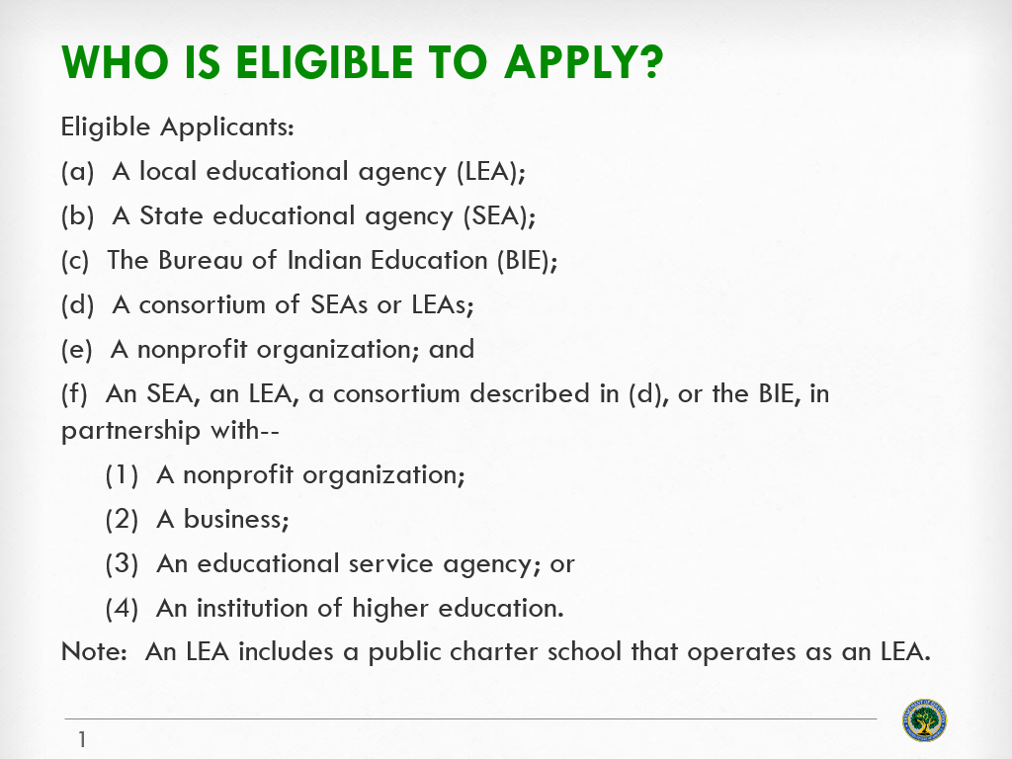
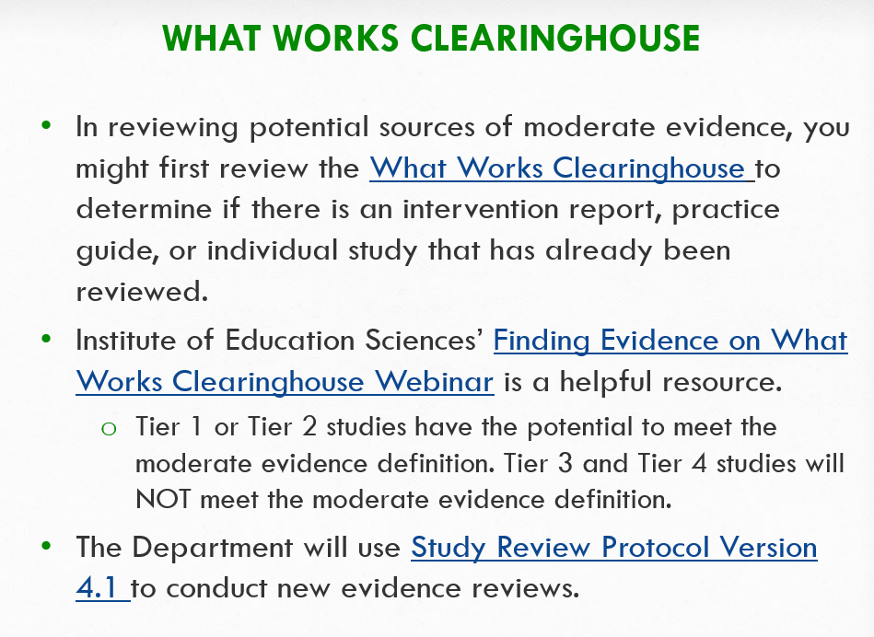
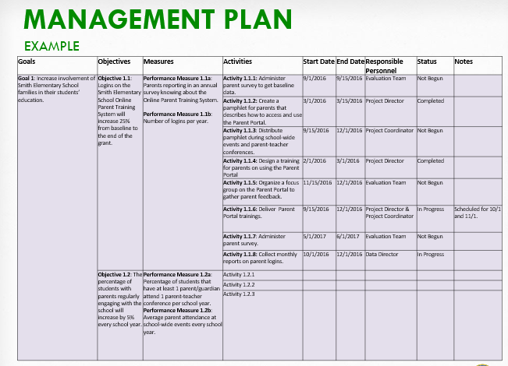
Other EIR Informational Slides
Eligibility
General Requirements
Priorities and Evidence Requirements
Selection Criteria and Scoring
Preparing a Budget Narrative
Documents to Include in an Application
Applying in Grants.gov
Slides are on the FY2021 Competition Page
Notes:
In your grant application, the entity name as listed on the Standard Form-424, box 8a must be the legal name of an entity eligible for an EIR grant.
There is a very specific list of eligible entities comes directly out of the EIR statute.
Based on this list of eligible entities, we want to highlight that applications can only be submitted by an LEA, SEA, BIE, or nonprofit organization.

Slide 23
Notes:
For reference, here is the LEA definition

Slide 25
Notes:
For reference, here is the SEA definition

Slide 26
Notes:
In the EIR program, institutions of higher education can apply directly only if they have nonprofit status and can include in their application an Internal Revenue Service determination letter on their status as a 501(c)(3) organization or can provide any of the other documentation set out in 34 CFR 75.51.
A private IHE that is a nonprofit organization can apply for an EIR grant.
A public IHE without 501(c)(3) status (even if that entity is tax exempt under Section 115 of the Internal Revenue Code or any other State or Federal provision), or that could not provide any other documentation described in 34 CFR 75.51(b), however, would not qualify as a nonprofit organization, and therefore could not apply for and receive an EIR grant.

Slide 27
Notes:
To avoid confusion about institutions of higher education, let’s summarize some of the different possibilities.

Slide 28
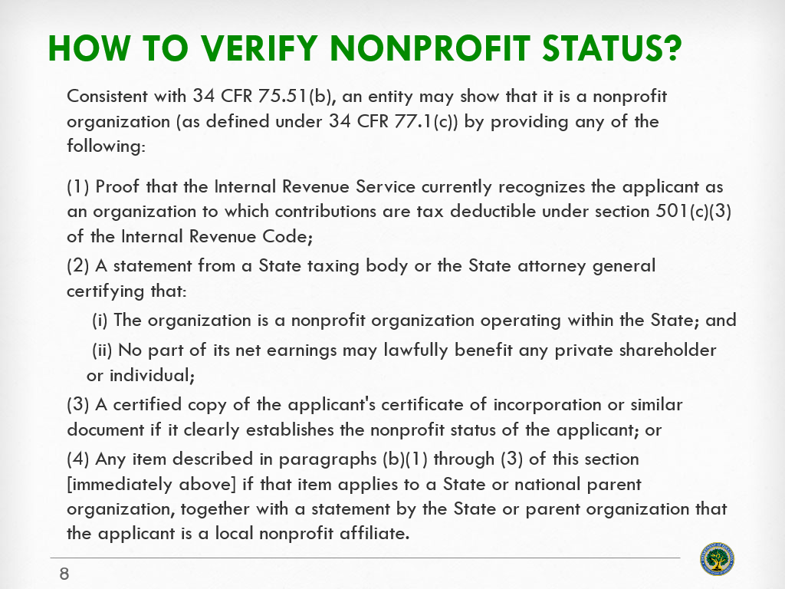
Notes:
Applicants need to provide nonprofit documentation which could include any of the 4 options as listed here. We ask that this be provided in Appendix A of your grant application.

Slide 29
PRACTICE – WHO Can APPLY?
Entity Type | Yes/No/ Maybe | Comment
My Franchise Public Charter School | Maybe | Yes if the charter school has LEA status; otherwise, no.
Distinguished University | Maybe | Yes, if the college or university meets the definition of nonprofit, or an affiliated nonprofit can apply.
Scores Go Up! Tutors (a commercial business) | No | Businesses can be partners in a project but cannot be the lead applicant.
The Bureau of Indian Education | Yes | The BIE may apply, but BIE schools may apply only if they meet the definition of LEA in the application notice.

Slide 30
PRACTICE – WHO Can APPLY?
Entity Type | Yes/No/ Maybe | Comment
Big Grey Apple School (a single school) | No | LEAs may apply, but not individual schools.
Olympia Forest Consortium of Five Distinct LEAs | Yes | One LEA in the consortium will need to serve as the lead applicant.
Mary Smith (a private citizen) | No | Individuals are not eligible entities.
A State Office of Children and Family Services | No | SEAs may apply, but not other State agency offices.

Slide 32
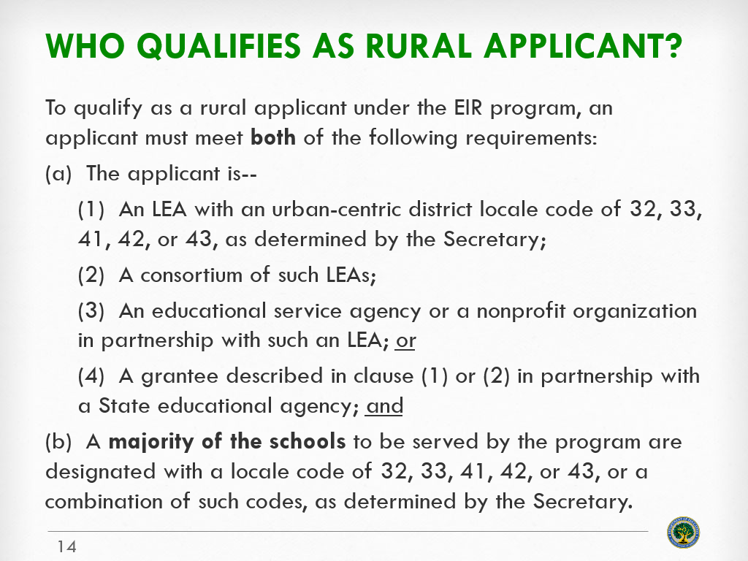
Notes:
25% of funds awarded under EIR will go to rural applicants, if the program receives a sufficient number of applications of sufficient quality. If you are applying as a rural applicant, you must meet both of these requirements listed here: being or partnering with a rural LEA and serving a majority of rural schools. Applicants are encouraged to provide relevant documentation of rural LEAs and rural schools, including providing the specific locale codes, in Appendix F of the application.

Slide 33
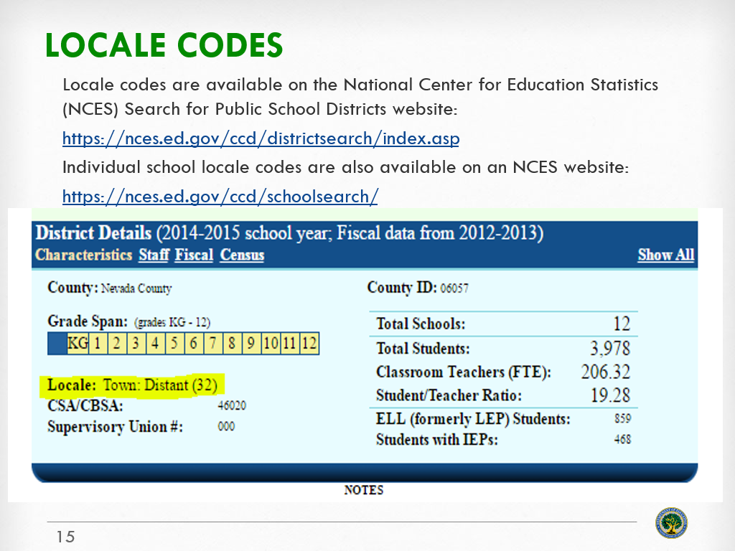
Notes:
Rural determinations are made based on the NCES locale codes.
The links on this slide can be used to determine if LEA and proposed sites are locale codes of 32, 33, 41, 42, or 43.

Slide 34
Notes:
Here are two legal applicants offered as examples. Do they qualify as rural applicants? Both of these examples represents eligible applicants and therefore can compete for EIR funds, but neither would qualify for the 25% of EIR funds that will be set aside for rural applications.

Slide 35
Notes:
To support rural applicants in submitting proposals that respond to the evaluation expectations aligned to the tier they are submitting under, we’ve compiled a set of resources for consideration.

Slide 36
Resources Related to the COVID Response Priority
Reopening Schools Handbooks
National Comprehensive Center’s Education Stories from the Field and Summer Learning and Enrichment resources
Regional Educational Lab (REL)’s COVID-19: evidence-based resources
Identify Learning Needs: Response to Intervention Practice Guide; REL Early Warning Systems publications
Learning Recovery and Personalized Learning: Comprehensive Center Network’s Succeeding During the Pandemic and Tutoring Programs and Academies for Learning resources; Federal Universal Design for Learning Centers; Out of School Time Practice Guide
CONNECTING SOLUTIONS: Technology Interventions in Economically Disadvantaged Communities
Social and Emotional Learning: Comprehensive Center Network’s Resources; Compendium
National Center on Safe Supportive Learning Environment’s COVID resources; Center to Improve Social and Emotional Learning and School Safety
Student Engagement and Attendance
Notes:
The Department offers an illustrative, but not exhaustive, set of resources for potential consideration for project ideas. These examples may not fully include the supporting evidence needed so you may need to explore the additional evidence slides to also find evidence to include in your application.

Slide 37
Resources Related to the EQUITY Priority
Comprehensive Center Network’s (CC Network): Equity Policy Briefs and Practice Guides
Regional Education Lab (REL) publications: Beating the Odds; Culturally Responsive Practices to Close the Achievement Gap; and Preventing Summer Learning Loss
Center for Education Equity’s State Leading for Equity
Mid-Atlantic Equity Consortium’s Time Act: How School Superintendents Keep Equity at the Center of Their Leadership
Great Lakes Equity Center
Equity in SEL
Implementation of Equity and Inclusion in STEM/CS
Notes:
Additional resources are here as well for those considering the equity priority.

Slide 38
Dates to remember
Early-phase (84.411C)
Application available: July 28, 2021
Deadline for transmitting applications:
August 27, 2021 11:59:59 PM Eastern Time
Awards announced December 2021
Project start dates: January 1, 2022

Slide 39
Other EIR Informational Slides
Eligibility
General Requirements
Priorities and Evidence Requirements
Selection Criteria and Scoring
Preparing a Budget Narrative
Documents to Include in an Application
Applying in Grants.gov
Slides are on the FY2021 Competition Page
Notes:
This overview webinar is intended to provide the high-level information about EIR.
Each application will be reviewed under the competition it is submitted under in the Grants.gov system, and only applications that are successfully submitted by the established deadline will be peer-reviewed. Applicants should be careful that they download the intended EIR application package and that they submit their application under the intended EIR competition.
In addition, you’ll need to learn more about some of the general requirements relevant to each EIR competition; and to learn more about the features that are unique to each tier.
To support you in this, we’ve prepared a series of informational slides that will help you do that, and we recommend strongly that you review those details included.
To highlight a few specifics as illustrated in the screen shots on the slides, in the general requirements slides, we’ve added some new resources to help you think through how to connect your logic model to performance measures. The priorities and evidence slides have some new resources about how to navigate the What Works Clearinghouse to select evidence. The selection criteria slides include some really useful examples for developing your management plan.

Slide 40
EIR Competition Resources
EIR Program Website
FY2021 Competition Page
EIR email: eir@ed.gov
EIR phone: (202) 453-7122
Discretionary Grantmaking at ED
Notes:
There are a number of resources available to you as you review the information on the EIR program and prepare and submit your application. If you have questions, based on the NIA or the content of this webinar, please reach out using the resources included on this slide.
Your first resource is the EIR website and specifically, the FY 2021 EIR Competition page is where we have links and documents to help you better understand the program, requirements, and submission procedures.
You may contact the EIR team via email or phone.
Please do note that to ensure transparency, consistency, and a level playing field, the Department will not advise or discuss whether the applicant meets the eligibility requirements or discuss projects with an applicant.

Slide 41
Call for Peer Reviewers
EIR seeks reviewers in the following areas:
If interested in being a peer reviewer, please review the Call for Peer Reviewers. You can also email eirpeerreview@ed.gov.
Program Evaluation/ Research | Rural Education | STEM | Computer Science
Personalized Learning | Trauma-Informed Practice | Social Emotional Learning | Multi-Tier Systems of Support
Expanded Learning | Distance/Online/ Hybrid Learning | Educator Equity/ Diversity | Resource Equity
Notes:
If you choose not to submit a grant application and will not participate in any other application to this year’s competition, you may be interested in volunteering to serve as a peer reviewer. EIR seeks reviewers in all areas of K-12 education, but particularly needs reviewers with expertise in K-12 computer science education. If interested in being a peer reviewer, please follow the instructions in the Call for Peer Reviewers located on the program website (listed on the prior slide), under the Applicant Info and Eligibility page. The call for reviewers also includes details about the schedule, payment, and reviewer responsibilities.

Slide 42
Thank you!
EIR email: eir@ed.gov
EIR phone: (202) 453-7122
Notes:
In closing, we also recommend that you not wait until the last minute to submit your application. If your application is late, even by a few minutes, it will not be eligible for review and funding.
So please familiarize yourself now with the application package and the Grants.gov system; make sure now that your passwords are up to date and working; and allow plenty of time before the deadline to submit your application.
Thank you for your time today. Please contact us if you have additional questions.

