Slide 1


Do Now
What do you see as the largest resource equity challenge in your district?
How are you using data to inform how you approach this challenge?
Resource equity: Resources (time, people, and money) are distributed across students and schools commensurate with need to create a “level playing field” from which all students can excel.
Notes:
Materials: Poster paper and marker to capture responses

Slide 2

District Strategic Planning and Resource Allocation Community of Practice (CoP):
Superintendent Session
6/30/2017
Notes:
Dan offers overall Consortium welcome message
Aaron shares welcome to State Support Network (NOTE: This June 30th group includes Sups from the pilot districts as well as the rest of the Consortium members, so the Welcome should take that into account to not confuse folks)

Slide 3

We are…
a technical assistance initiative designed to support
State and district school improvement efforts.
Notes:
Melissa provides an overview about the Network.
We are funded by the Office of State Support at the US Department of Education.

Slide 4
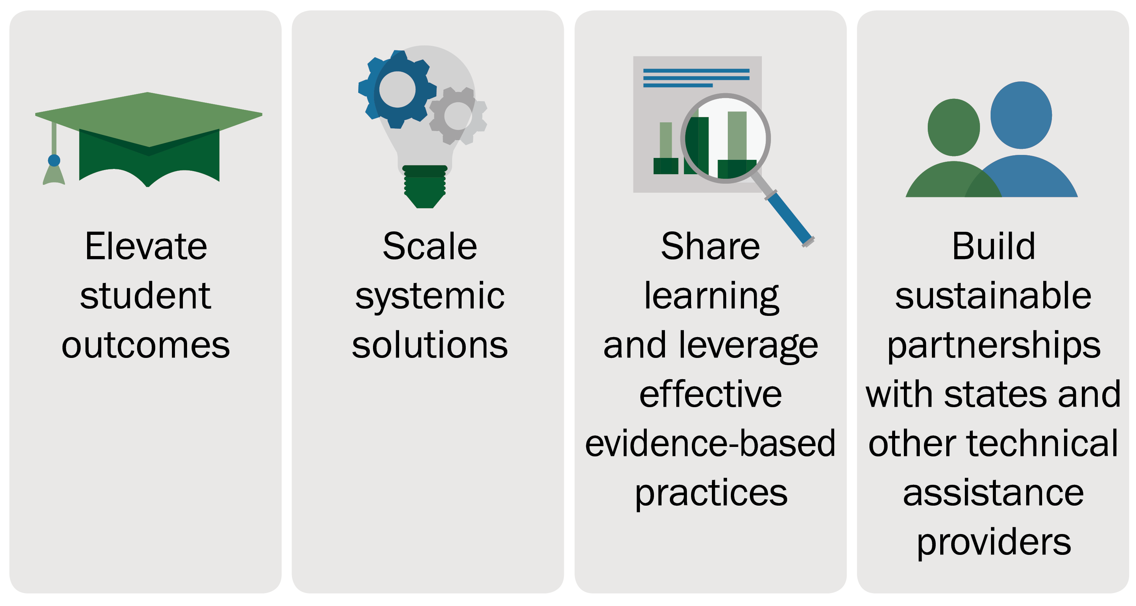
We collaborate with states, districts, and technical assistance providers to:
Notes:
Melissa provides an overview about the Network.

Slide 5
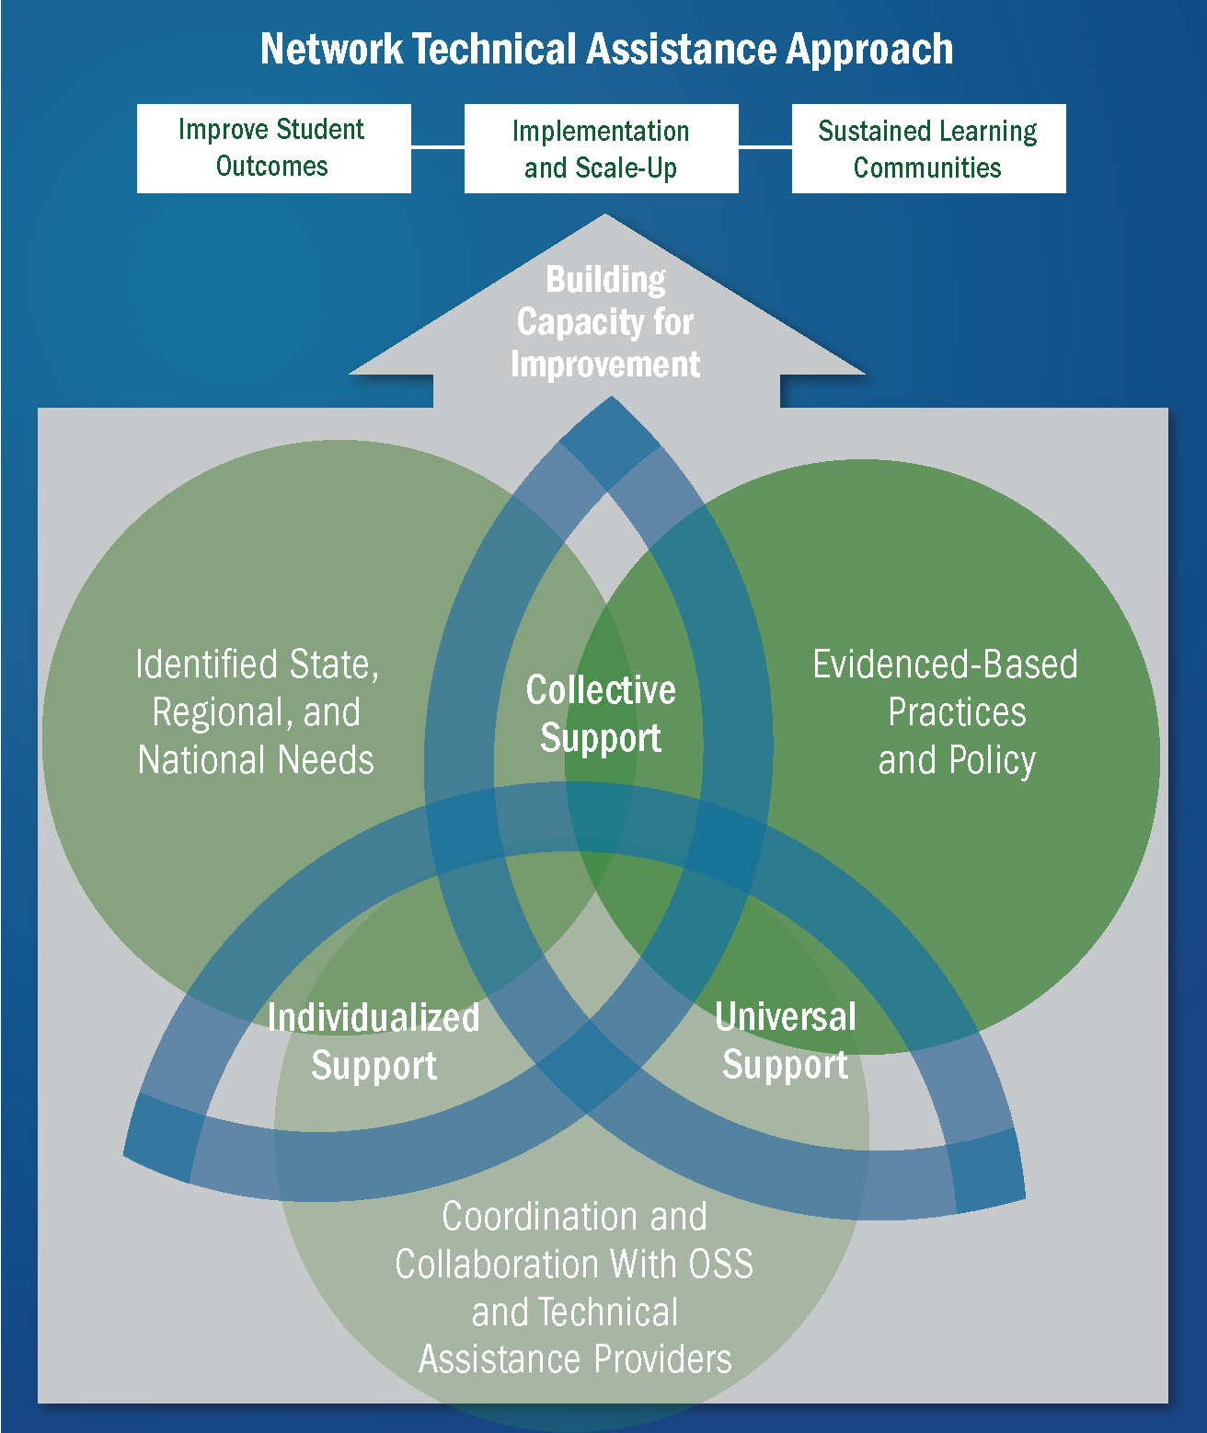
Notes:
Aaron provides an overview about the Network.
Universal support through broadly shared school improvement resources organized on a user- friendly website. Resources will include case studies, guidelines, and checklists for implementation, among other materials.
Collective support for technical assistance delivered in person and virtually and shared by multiple organizations, so that States can learn and collaborate through peer-to-peer experiences and communities of practice led by technical assistance providers.
Individual support focused on direct technical assistance from subject matter experts delivered in person and virtually to address special State and district needs.

Slide 6
ERS: Our Mission
ERS is a non-profit organization dedicated to transforming how urban school systems organize resources (people, time, technology, and money) so that every school succeeds for every student.
Notes:
SPEAK TO: The State Support Network works with national subject matter experts to support priority work. ERS is working with the State Support Network to lead this CoP.

Slide 7
Do Now
What do you see as the largest resource equity challenge in your district?
How are you using data to inform how you approach this challenge?
Resource equity: Resources (time, people, and money) are distributed across students and schools commensurate with need to create a “level playing field” from which all students can excel.
Notes:
Note: This slide is intentionally the same as the first one. It is a facilitation decision to have the first slide up when participants enter. They will get started on the Do Now when they arrive. Then, when we kick off the day, we will move to the intro of the Network and ERS and presenters. Then, we will come back to this to have it up for participants to speak to as part of their own introductions.

Slide 8
Timeline for Activities
This session is the first of three key conversations in the District Strategic Planning and Resource Allocation Community of Practice (CoP).
April
May
June
July
Aug.
Sept.
2018+
March
April
June 29
July 14
Post CoP
Data collection and analysis begins
(Pilot group)
Kickoff online collaboration session
(Pilot group)
Financial reporting and transparency
(Pilot group, in Boston)
Learnings from pilot shared back with Consortium and inform future work
March
June 30
August or September TBD
Pilot district selection
Exploring resource equity risks and opportunities
(Full group, in DC)
Sample reports and communicating with stakeholders
(Pilot group, online collaborative)
Today
Key sessions
Notes:
Framing: This session is about hearing from the LCSDC district leaders as a group to inform the pilot group’s conversations, whose takeaways will be then shared back to the LCSDC.

Slide 9

Pilot Group Objectives
Methodology:
  Explore how current financial reporting structures and practices prevent fully accurate per pupil reporting at school level
  Identify “imperatives” to communicate to state level methodology developers
Reporting Strategy:
  Understand the primary drivers and causes of variation in per pupil spending
  Identify supporting school level data needed to responsibly interpret and explain spending variation
Engagement:
  Define key messages to facilitate discussions of spending equity, focusing on priority policy options and approaches
Notes:
Notes:
Speak to who is currently in the Pilot Group (if not shared already)
Share invitation – If any other district is interested in joining, contact Jonathan Travers
Speak to how the COP plans to address each of these objectives
Full wording for objectives is below for reference. The text on the slide is an abbreviated version.
1. Methodology:
Identify the primary ways in which current financial reporting structures and practices prevent fully accurate per pupil reporting at school level
Identify 2-3 “imperatives” to communicate to state level methodology developers that hinder a district’s ability to fully allocate expenses at the school level
2. Reporting & Accountability Strategy:
Understand the primary drivers and causes of variation in per pupil spending across schools in their district, including different dimensions of student need, school size, teacher compensation
Identify supporting school level data needed to responsibly interpret and explain why some schools spend more or less than others in their system
3. Engagement:
Lay out key messages for Superintendent, Board and other stakeholders to facilitate discussions of spending equity that focus on most important policy options and approaches

Slide 10
Goals for Today’s Session
Explore the risks and opportunities of using ESSA’s financial transparency requirement as part of your equity strategy
Capture feedback on how best to approach this work to maximize opportunity and minimize risk

Slide 11
Today’s Agenda
Time | Topic
9:00 – 9:20 | Welcome, introductions, and norms
9:20 – 9:25 | What we know about ED implementation of this ESSA provision
9:25 – 10:20 | Financial reporting and transparency: Risks and opportunities
10:20 – 10:30 | Closing: Next steps

Slide 12
Per-pupil Expenditure Reporting in ESSA
A State and its LEAs must annually report per-pupil expenditures of Federal, State, and local funds on State and LEA report cards, disaggregated by source of funds.
Per-pupil expenditures must include actual personnel and non-personnel expenditures.
A State and its LEAs must report per-pupil expenditures for the LEA as a whole and for each school served by the LEA for the preceding fiscal year.
ESEA section 1111(h)(1)(C)(x), (h)(2)(C)

Slide 13
Reporting Timeline
As stated in the June 28, 2017, Dear Colleague Letter, the U.S. Department of Education is giving States and LEAs until the 2018-2019 school year to report on annual report cards regarding per-pupil expenditures as described on the previous slide.
If an SEA elects to delay reporting, on the 2017-2018 report cards, the SEA and its LEAs must provide a brief description of the steps the SEA and LEAs are taking to ensure that information on the per-pupil expenditures will be included beginning with report cards for the 2018-2019 school year.

Slide 14
Today’s Agenda
Time | Topic
9:00 – 9:20 | Welcome, introductions, and norms
9:20 – 9:25 | What we know about ED implementation of this ESSA provision
9:25 – 10:20 | Financial reporting and transparency: Risks and opportunities
10:20 – 10:30 | Closing: Next steps

Slide 15
Greater Transparency = Greater Resource Equity?
5 min
If districts report per-pupil expenditures at the school level...
And they 1) do so accurately and completely, 2) identify causes of funding variation, 3) include other metrics to show full equity picture…
It will enable report users (parents, community members, teachers, principals, district staff) to generate key insights…
That will ultimately lead to specific actions (equity moves)…
Which will mean resources will be distributed more effectively and equitably…
Then student performance will improve.
What is the theory that greater transparency in funding at the school level leads to greater equity in outcomes for kids?

Slide 16
Variation in Spending
Drives higher spending
Drives lower spending
Variation does not in itself mean resource inequity. We must examine it within the school’s overall context.
School | $ PP |  | High Avg. Teacher Compensation? | Accurate Enrollment Projection? | Large SWD Population? | Large FRL Population? | Large ELL Population? | School Size?
A | High |  | Low | Over-Projected | Above avg. | Above avg. | Average | Small
B | High |  | Low | At Projection | Average | Above avg. | Above avg. | Small
C | High |  | Average | Over-Projected | Below avg. | Average | Average | Small
D | High |  | Low | Over-Projected | Above avg. | Above avg. | Above avg. | Average
E | High |  | Average | At Projection | Above avg. | Average | Above avg. | Average
V | Low |  | Average | At Projection | Below avg. | Average | Average | Average
W | Low |  | Average | Under-Projected | Average | Below avg. | Above avg. | Large
X | Low |  | Average | At Projection | Average | Average | Below avg. | Average
Y | Low |  | High | Under-Projected | Below avg. | Below avg. | Below avg. | Large
Z | Low |  | High | Under-Projected | Below avg. | Below avg. | Average | Large
High $ PP
Low $ PP
Notes:
Notes:
1. We are planning on spending several minutes speaking to and digesting this together as a group.
2. The takeaway is in the sub-title. Schools with higher $pp typically have largest Special Education and ELL populations, not that they are over or under funded with higher than avg teacher comp. This has significant implications for how we show $pp at the school level and how we engage stakeholders in the data.

Slide 17
Outcomes and Risks
15 min
Based on what you know about your equity and excellence challenges and any past efforts to share spending data…
What are the most positive outcomes you can imagine from increasing transparency around school level spending and equity metrics?
What are the biggest risks you can imagine?
How might advocates and stakeholders in your community use this data? What steps could you take to empower them to use it well and fairly?
Take 5 minutes to write down your thoughts
to share with a partner.
Notes:
Materials: Poster w/these pre-written on it
Note: Notes added to a chart paper so we can continue to refer back to them
5 min individual
5 min pair share
5 min whole group

Slide 18
Maximizing and Mitigating Risks
15 min
In order to maximize the positive and mitigate the risks of this financial transparency requirement, what must be true:
About the reporting?
To build political capital?
To engage stakeholders?
What does that mean for how we must approach this work to maximize opportunity and minimize risk?
Notes:
Materials: Poster w/these pre-written on it
Note: Continue to add notes to a chart paper so we can continue to refer back to them
10 min Divide into 2 groups – One led by Dan, one led by Jonathan. Record notes on chart paper.
10 min Whole group discussion (stay in break out groups)

Slide 19
Working with Your SEAs
15 min
How can your team influence SEA design and implementation around this requirement (methodology, reporting, etc.) - and is this an opportunity to provide direction and leadership?
What resources/supports would you need to effectively engage your SEA on this?
Notes:
Materials: Poster w/these pre-written on it
Note: Continue to add notes to a chart paper so we can continue to refer back to them
10 min Small group discussion
5 min Whole group discussion

Slide 20
Today’s Agenda
Time | Topic
9:00 – 9:20 | Welcome, introductions, and norms
9:20 – 9:25 | What we know about ED implementation of this ESSA provision
9:25 – 10:20 | Financial reporting and transparency: Risks and opportunities
10:20 – 10:30 | Closing: Next steps

Slide 21
Self-Reflection and Discussion
10 min
What two learnings from this discussion will you share with your teams (e.g., CFO, CAO, Strategy Officers, etc.) when you return to your districts?
Take 3 minutes to write down your thoughts
to share with a partner.
Notes:
Materials: Poster paper and marker to capture responses
Note 1: Either add this to the notes you’ve already captured on the chart paper (e.g., place check-marks next to the things folks say they will bring back)
3 min self reflection
4 min pair share
2 min ask for a few share-outs
1 min Thank You
Note 2: Feedback forms will be given at the end of the LCSDC conference via survey monkey.

Slide 22
This document was produced by American Institutes for Research under U.S. Department of Education contract number ED-ESE-15-A-0006/0001. The content of this document does not necessarily reflect the views or policies of the U.S. Department of Education, nor does mention of trade names, commercial products, or organizations imply endorsement by the U.S. government. Authorization to reproduce this document in whole or in part for educational purposes is granted.

