Slide 1
Javits Program Project Director’s Meeting October 29, 2020
Jacob K. Javits Gifted and Talented Students Program

Slide 2
Housekeeping Rules
Please remember the following:
MUTE your phones and computers (use the “mute” on your device or press *6)
Do NOT utilize the HOLD function—this will place the entire call on hold. Simply hang up and dial back in when you’re able.
Use the chat feature to ask questions.
Sit back, relax, and enjoy the show!

Slide 3
Agenda
Welcome and Team Introductions
Communication Practices
Grantee Responsibilities
Performance Reporting
Continuation Awards
Financial Reporting
Monitoring
Reporting Dates
Plenary Session
Questions and Answers

Slide 4
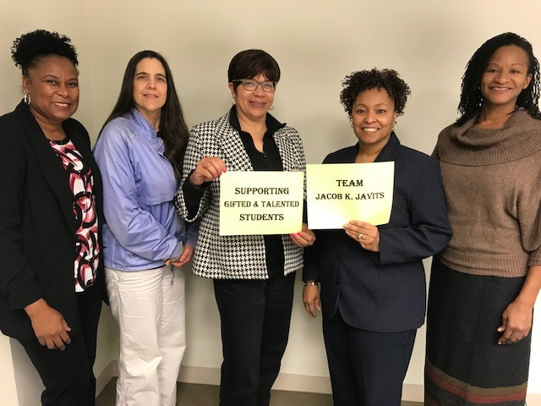
The Javits Team

Slide 5
Our Team
The Javits Team is within the Office of Academic Improvement Group, organized under the Office of Well-Rounded Education in the Office of Elementary and Secondary Education (OESE)
Sylvia E. Lyles, Ph.D.—Director, Office of Well-Rounded Education, OESE
Michelle Georgia —Group Leader, Academic Improvement Group
M. Jeanette Horner-Smith—Javits Program Officer/Team Leader
Gay Ojugbana—Javits Program Officer
Charm Smith—Javits Program Officer

Slide 6
Javits Program: Communication Practices
Program Officer – Primary Contact for Grants
Building relationships for success in grant programs
Obtaining information and addressing concerns
Asking tough questions
Responding swiftly
General information regarding the Javits Program, regulatory and statutory guidance
Emails regarding performance, obligations, and due dates
Available for questions
Team Leader – Secondary Contact for Grants

Slide 7
Javits: Grantee Responsibilities
Read and understand the terms and conditions listed on the Grant Award Notification (GAN)
Submit required reports in timely manner
Maintain documentation
Draw down funds from G5 per your budget
Adhere to the scope or objectives of the project as described in grantee application

Slide 8
Performance and Budget Reporting Requirements
Annual Performance Report (APR)
Budget Revisions
Performance Check-In Calls with Program Officer
Requirements issued in Grant Condition
Information as requested by Program Officers

Slide 9
Annual Performance Reports (APRs) Requirements
Federal Grant Requirement as noted in Grant Award Notification (GAN)
Report progress on meeting goals and objectives
Report progress for the complete year of performance and spending (Ex. Oct 1, 2019-Sept 30, 2020)
APRs will be submitted through G5
Complete ED 524b form
Section A – Cover page
Section B - Performance
Section C - Budget

Slide 10
Annual Performance Report Dates
Reporting Progress in APR:
FY 17 & 19 Grantees:
October 1, 2019 – September 30, 2020 (Due Dec 14, 2020)
FY 18 grantee:
December 7, 2019 – December 6, 2020 (Due Dec 30, 2020)
FY 20 grantees - APRs submitted at the end of FY 2021
FY 14 & 15 Grantees with No Cost Extensions:
Annual Performance Report required as part of no cost extension request

Slide 11
Interim Performance Check-in Calls
Mid-Year Performance Reporting
All Grantees are required to keep program officer informed of changes in completing project performance measures and managing budget.
Performance updates on:
Progress
Challenges
Identifying need for assistance
Grant Conditions IF required in GAN

Slide 12
Interim Performance Check-in Calls
Calls will occur mid-year of budget period and whenever deem necessary by your Program Officer.
2021 Check-in Call Schedule:
FY 17,19 and 20 Grantees: March / April 2021
FY 18 Grantees: April 2021
FY 14 & 15 Grantees with No Cost Extensions: March 2021

Slide 13
Substantial Progress
Substantial Progress is defined as:
“ A level of achievement that a grantee must meet in its project during a budget period, which can be measured and verified by evidence, so the grantee can receive a continuation award.” (EDGAR 75.253)
Grantees will document substantial progress in a performance report.

Slide 14
Continuation Funding
EDGAR 75.253
Continuation funding is contingent upon:
Substantial progress and the availability of funds
Substantial progress towards meeting the program goals and objectives
Submission of required reports (Interim Check-in Calls and Annual Performance Report)

Slide 15
Financial Reporting Requirements
Budget Revisions
Work with your Program officer when revising budgets
Budget revisions must be:
Consistent with the project goals and objectives
Must NOT change the scope of project.
Revised Budgets Due Dates:
FY 17 Grantees: Year 4 budgets – December 14, 2020
FY 18 Grantee: Year 4 budget – December 30, 2020
FY 19 Grantees: Year 2 budgets – December 14, 2020
FY 20 Grantees: Year 1 budgets – (New Grants) As soon as possible (No later than December 14, 2020)

Slide 16
Financial Reporting
Draw down funds in G5:
Must be timely to align with project timelines.
Funds in G5:
Reflects the fiscal side of grant performance only
Does not display funds obligated by grantees
Grant funds obligated only during the grant period
Performance period end date on grant award is the last day to obligate funds.

Slide 17
Financial Reporting Requirements
Carry Over Funds: Unused grant funds can carry over from year to year within a budget period (e.g., from Year 1 to Year 2).
Carry Over Funds must be calculated in budget revision.
Carry Over Funds can lead to reallocated funds in budget line items.

Slide 18
Financial Reporting Requirements
Allowable Cost according to Federal cost principles:
Expenditures must be Reasonable, Allowable and Allocable.
Cost must be directly related to a specific objective under the grant award (Javits Project).
Indirect costs:
Only calculated against the first $25,000 of each individual contract in the budget contracts line item.

Slide 19
Javits: Grant Monitoring
If Program Officers determine issues with a Javits project – Expect an email or a call anytime.
Performance Check-in Calls – March / April 2021
On-Site Visits or Virtual Monitoring - Some grants will be selected for additional monitoring activities
Comprehensive and Targeted Monitoring
Provide Additional Webinars and other meeting events – As needed for technical assistance

Slide 20
ReCap of Reporting Dates and Deadlines
Annual Performance Reports (APRs):
FY 17 Grantees: Year 3 Report – December 14, 2020
FY 18 Grantee: Year 3 Report – December 30, 2020
FY 19 Grantees: Year 1 Report – December 14, 2020
Budget Revisions:
FY 17 Grantees: Year 4 budgets – December 14, 2020
FY 18 Grantee: Year 4 budget – December 30, 2020
FY 19 Grantees: Year 2 budgets – December 14, 2020

Slide 21
ReCap of Reporting Dates and Deadlines
Final Performance Reports (FPRs):
FY14 & 15 Grantees: No later than 90 days after the end of grant period

Slide 22
2021Reporting Requirements
Check-in Calls: Mid-Year (Interim) Reporting:
FY 17, 19 & 20 Grantees: March / April 2021
FY 18 Grantee: April 2021
Budget Revisions (Anticipated Carryover):
FY 17 Grantees: Year 5 Budgets
FY 18 Grantee: Year 5 Budget
FY 19 Grantees: Year 3 Budgets
FY 20 Grantees: Year 2 Budgets

Slide 23
Questions & Answers

Slide 24
Plenary Session
Project Directors Leading Sessions:
Greenville County Schools (S206A170029)
Project Director: Jane Snyder
University of Hawaii (S206A140012 & S206A170014)
Co-Principal Investigator: Kiriko Takahashi
(Project Director: Hye Jin Parks)
University of Connecticut (S206A190028)
Project Director: Del Siegle

Slide 25
Transitioning to Virtual Activities during the Pandemic Greenville County Schools, Project Director: Jane Snyder
Discussion Points
Developing Effective Virtual Training Sessions
Creating Opportunities for Involving Others
Adopting Virtual Procedures and Conducting Trial Placement

Slide 26
Progress and Challenges while Completing Project Performance University of Hawaii, Co-Principal Investigator: Kiriko Takahashi
Project BEAM (BE A Mathematician) – A Scale Up and Evaluate Model
An Intervention Program for Project BEAM
Testing the Effectiveness of the Model Using A Cluster Randomized Trial
Restructuring Intervention Lessons and Developing a New Implementation Plan

Slide 27
Lessons Learned from Project Goals and Objectives Unexpected Bright Spots during the Pandemic and Impact on Project University of Connecticut, Project Director: Del Siegle
Tips for Conducting Research in the Age of COVID:
• Use Microsoft Teams To Keep the Team Organized Online
• Scheduling and Preparing Professional Learning Is Different
During COVID-19
• Use Technology as a Great Tool for Data Collection
• Create New Opportunities Under New Conditions By Revisiting
Your Objectives
• Take Time to Develop Good Instrumentation

Slide 28
If you have additional questions that were not answered please contact your Program Officer.

Slide 29
Javits Team Contacts
M. Jeanette Horner-Smith, Ph.D. —Team Leader
Mildred.Horner-Smith@ed.gov / 202-453-6661
Gay Ojugbana— Program Officer
Gay.Ojugbana@ed.gov / 202-260-1461
Charm Smith— Program Officer
Charm.Smith@ed.gov / 202-205-5724
Michelle Georgia — Group Leader
Michelle.Georgia@ed.gov / 202-453-5501

Slide 30
Thank you for joining us today!
Best wishes in completing your Javits Project while fulfilling federal grant requirements.

