Slide 1
Discretionary Grants
Performance reporting
Jacob K. Javits Gifted and Talented Students Program
January 30, 2020
2:30 – 3:30pm (ET)
Notes:
Welcome to the Performance Reporting Webinar for the Jacob K. Javits Gifted and Talented Students Program.

Slide 2
House Keeping Rules
Please remember the following:
MUTE your phones (use the “mute” on your device or press *6)
Do NOT utilize the HOLD function—this will place the entire call on hold. Simply hang up and dial back in when you’re able.
Use the chatbox to ask questions. Direct them to the HOST or ALL PARTICIPANTS.
Let’s begin!

Slide 3
Agenda
Performance Period vs Budget Period
Reporting Requirements Changes
Maintaining Performance
Annual Performance Reporting (APR)
Budget Revisions
Final Performance Reports (FPR)
No Cost Extensions
Reporting Dates and Deadlines
Notes:
The agenda for the presentation consist of:
An overview of performance period and budget period to gain insight for reporting.
Changes in the reporting requirements
Strategies for maintain performance
Requirements for completing Annual Performance Reporting (APR)
Discussions on how to complete Budget Revisions
Requirements for completing the Final Performance Report (FPR)
Requirements for No Cost Extensions (NCEs)
And a snapshot of the reporting dates and deadlines

Slide 4
Performance Period vs Budget Period Overview
Refer to information listed on the Grant Award Notification (GAN)
Project Period - period during which funds can be obligated
  Report progress on project goals and objectives as defined in approved Grant Application
Budget Period - An interval of time into which a project period is divided for budgetary purposes.
  Financial plan for carrying out the project or program (yearly)
  Report on obligations, draw downs, and carryover
Project period for Javits Program awards is 5 years, however each budget period is for one year.
  Congressional appropriations for budgets are conducted annually in which the availability of funds are determined.
Notes:
A project period, sometimes referred to as the performance period, is the entire project from beginning to end. Under EDGAR § 75.250, ED can fund a project for up to 60 months unless a program statute or regulation provides for a longer project period. A project period can also be less than a year.
Period of performance means the time during which the non-Federal entity may incur new obligations to carry out the work authorized under the Federal award. The Federal awarding agency or pass-through entity must include start and end dates of the period of performance in the Federal award.
Congress appropriates most ED funds on a fiscal year basis, meaning the funds are available for obligation by ED for only one fiscal year. Few discretionary grant programs make funds available for obligation for more than one year. However, under discretionary grant programs, ED has flexibility to set the period that grant funds are available for obligation by the grantee. For the Javits Program – the project period is 5 years.
Budget periods are defined as follows:
When ED funds grants with project periods longer than a year, it generally funds the grants in annual increments called budget periods. A budget period is usually 12 months (see EDGAR § 75.251), and funding for each budget period generally comes from separate fiscal year appropriations.
Program officials may establish shorter or longer budget periods if there is a compelling program reason to do so, such as:
a. To arrange more advantageous start and end dates for the grantee;
b. To allow for project periods not evenly divisible into 12 month increments;
c. To take into account an unavoidable extended absence of a grantee’s principal investigator; or
d. To accommodate a change in the grantee’s fiscal year.
For the Javits Program – the project period is 5 years, however the budget period is on a one year basis.

Slide 5
Performance and Budget Reporting
Requirements
Annual Performance Report (APR)
Budget Revisions
Requirements issued in Grant Condition
Check-In Calls with Program Officer
Information as requested by Program Officer
Notes:
These are the specific requirements for reporting on performance of the project and budgets. These will be discussed in the next few slides and important information will be provided to address key changes for reporting on your Javits Projects.

Slide 6
Reporting Changes
Under EDGAR, 34 CFR 75.253(a)(3) grantees are required to submit their grant performance and financial data to the Department using Grant Performance Report form ED 524b for determining continuation awards
  ED 524B is required for Annual and Final Reporting
  Required to report on progress of project, budget, and indirect cost
Grantees are no longer requested to submit Interim Performance Reports (IPRs); there is sufficient data to determine substantial progress from the available Annual Performance Reports (APRs).
  In lieu of IPRs, program officers will conduct mid-year calls and emails
Information collected for determining substantial progress by other means.
  Scheduled Check-In Calls
  Other communications (emails, phone calls)
Notes:
It is important for the Department to make decisions about continuation awards therefore determining substantial progress is required.
In December 2019, FY 17 and 18 grantees submitted supplemental information to the Interim Performance Reports (APRs). This provided performance reporting that covered their year 2. Based on these report, enough information has been provided to determine substantial progress for the projects.
Key changes to reporting include:
No longer submission of Interim Performance Reports (IPR)
Schedule Check-In Calls

Slide 7
Maintaining Performance and Check-in Calls
It all begins with an approved grant application and the grant award notification (GAN).
  Review, revisit, and remember to include approved project information to maintain federal grants and complete projects.
All Grantees are required to keep program officer informed of changes in completing project performance measures and managing budgetary items.
Scheduled Check-In calls will begin in March 2020 to keep the Department updated on:
  Progress
  Challenges
  Identifying when assistance is needed
  Grant Conditions IF required in GAN
Check-In Calls will occur yearly at mid-point of budget period and whenever deem necessary by the program officer.
2020 Check-in Call Schedule:
  FY 19 and 17 Grantees: March / April 2020
  FY 18 Grantee: April / May 2020
Notes:
The Javits Team wants to ensure the performance is maintained therefore new to the reporting process is check-in calls.
It’s important to keep your Program Officer informed of changes.
Check-in calls will begin in March and will be conducted yearly at a mid-year point your budget period. This timeframe is based on each grants budget period.

Slide 8
Check-In Calls Requirements
Scheduled by program officer and could last up to 1 hour
Discussions for check-in calls will include:
  Progress on performance measures
  Budget Information: anticipated carryover amounts since receiving continuation awards
  Changes to Budget Line Items (personnel, contracts, indirect cost rates, supplies, etc.)
  Need for guidance to manage awards and reallocations
  Any other information that could impact the completion of the project and maintaining grant requirements
Check-in call information form will be standardized for all grantees however discussions will be streamlined to fit each grantee’s performance and financial obligations.
Calls will be scheduled during mid-year and as needed.
Notes:
Requirements for Check-In calls include:
Up to 1 hour discussions
Discussion areas
Standardized discussion protocol
Calls will be conducted mid-year as well as when needed. Your program officer will make the determination as to when additional calls are needed.

Slide 9
Annual Performance Reports (APRs)
Requirements
Report progress on meeting goals and objectives at the end of performance year.
  This consists of progress for the complete year of performance
Reported progress in APRs will cover the following timeframes:
  October 1, 2019 – September 30, 2020 for FY 17 and FY 19 grantees
  December 7, 2019 – December 6, 2020 for FY 18 grantee
APRs will demonstrate a complete year of progress in performance and spending.
APRs for FY 17 and FY 19 grantees are due no later than December 30, 2020.
APR for FY 18 grantee is due no later than January 30, 2021.
Due dates for submitting APRs were selected to allow time for program officers to review documents and determine substantial progress.
APRs will be submitted through G5.
Notes:
Requirements for completing APRs.
It is important to ensure that APRs are detailed, cover the required period, and submitted on time.
It must cover the performance timeframe of the grantee.

Slide 10
Annual Performance Reports (APR) Requirements: Complete 524b form
Part I: Grant Performance Report Cover Sheet
Part II: Project Status Chart Form (Actual – Targets)
  Section A -- Performance Objectives Information and Related Performance Measures Data
  Section B – Budget Information
    Include actual carryover amounts based on funds in G5
  Section C - Additional Information
Instructions will be provided for completing Project Status Chart
Notes:
Completing the ED 524b form to complete your APR.

Slide 11
FY 19 Grantees: Government Performance and Results Act (GPRA) Measures
Performance measures pursuant to the Government Performance and Results Act (GPRA) of 1993, for assessing progress toward achieving the purposes of the program:
  The number of students newly identified as gifted and talented under the program;
  The percentage of students newly identified as gifted and talented under the program who were served under the program;
  Of the students served under the program who were in tested grades, the percentage who made gains on State assessments in mathematics;
  Of the students served under the program who were in tested grades, the percentage who made gains on State assessments in science; and
  The number of teachers and other educators who received services that enable them to better identify and improve instruction for gifted and talented students.
FY 19 grantees must respond to GPRA measures in Section A of Project Status Chart.
Notes:
FY 19 grantees will be reporting on GPRA measures as outlined in your grant application. There are five GPRA measures to report on for determining progress.
This only applies to FY 19 grantees.
GPRA Performance measures must be reported on in APR.
For performance measure #5, the Department is particularly interested in evidence, such as may be obtained through surveys of teachers and other educators, that the services provided are of high quality and contribute to improved efforts to both identify and improve outcomes for gifted and talented students.
All grantees must submit APRs that include data addressing these performance measures to the extent that they apply to the grantee’s project. Performance targets must be established by each grantee for each year of the five-year performance period.

Slide 12
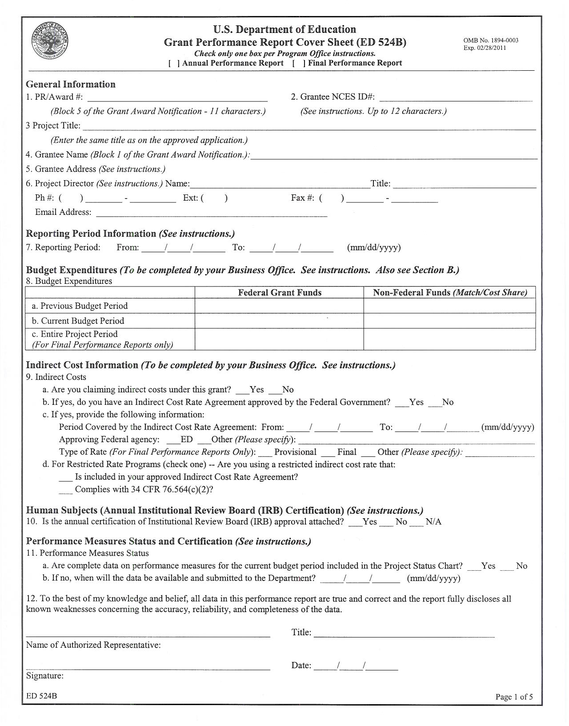
ED 524b Cover Sheet
Notes:
This slide provides an example of the cover sheet.
This includes: General Information about the grant
Reporting period
Budget Expenditures
Indirect Cost Information
Human Subjects Information
Performance Measures Status and Certifications

Slide 13
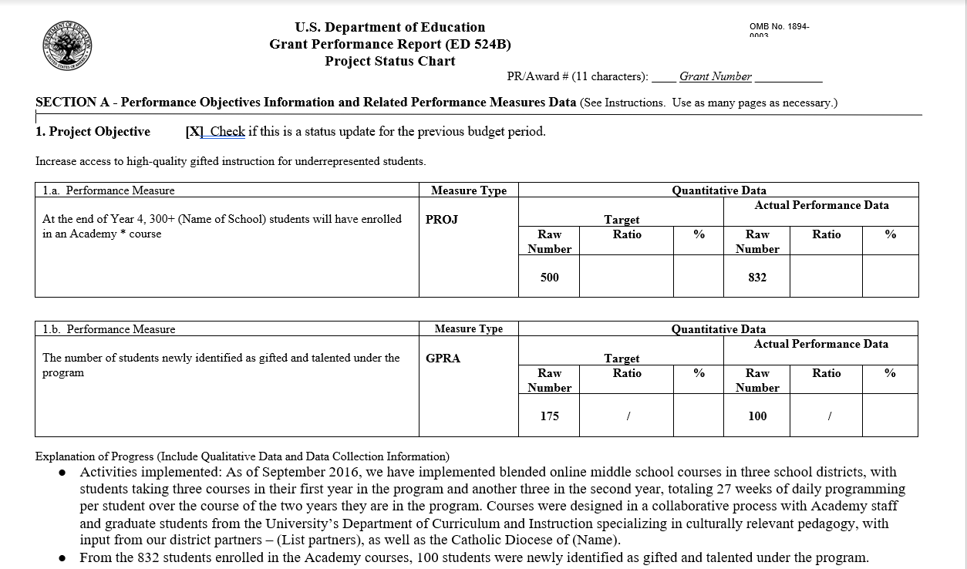
Progress Status Chart (Sec A): Project Objectives and Performance Measures (Example)
Notes:
This slide provide an overview of how to report on performance measures as required in the Project Status Chart
(Section A)
Use as many pages as necessary to support each objective outlined in the project..
Provide an explanation of the progress at the bottom of each objective
For GPRA measures include GPRA in the Measure Type box.
See examples for Section A of ED 524B form.
For qualitative and quantitative information – Report on progress in implementing the project objectives and measures;
Include whether the target for each measure was “met” or “not met”.
Project activities/strategies implemented to reach the target.
Strategies to be implemented if the target was not met.
Please note that in G5 there is a 4000 character limitation for each Project Objective.

Slide 14
Program Status Chart (Sec B): Budget Revisions
  Grantees are required to submit budget revisions as part of annual reporting
  Reasons to make budget revisions:
    To reallocate funds within line items that won’t impact the scope of the project
    To maintain reasonable, allowable, allocable costs across the project
    When the Program Officer identifies a lack of spending funds in G5 i.e. large amount of funds remaining after mid-point of budget period
  Provide detailed information on the funds expended and obligated for the budget period
  Explain if you did/will not expend funds at the expected rate during the reporting period.
  Explain the planned use of funds carried over into the next budget period
    Ex. FY 19 grantees: Year 2
  Note: FY 19 grantees in Year 1 – required to submit interim budget revisions to determine substantial progress for making continuation awards.
    Interim budget revisions are due March 16, 2020 (October 1, 2019 – February 28, 2020)
  All other grantees will not be required to submit interim budget revisions.
Notes:
Budget Revisions are important requirements for determining substantial progress.

Slide 15
Budget Revisions Requirements
CFR Part 200—Uniform Administrative Requirements, Cost Principles, and Audit Requirements for Federal Awards (Uniform Guidance)
Refer to original budgets submitted and approved in grant applications.
Budgets are revised yearly to account for cost changes, reductions, and carryover
Complete Budget sheet in 524b form for making revisions
Provide detailed narratives for changes to budget and carryover amounts per line item
Approval by the Department is required for major budget changes (Must be reasonable, allowable, and allocable)
  Refer to Uniform Guidance for determining allowable costs.
Budgets could impact continuations awards
Budget revisions are due prior to APR submission..
Notes:
CFR PART 200—UNIFORM ADMINISTRATIVE REQUIREMENTS, COST PRINCIPLES, AND AUDIT REQUIREMENTS FOR FEDERAL AWARDS
200.8 Budget. (CFR – Code of Federal Regulations)
Budget means the financial plan for the project or program that the Federal awarding agency or pass-through entity approves during the Federal award process or in subsequent amendments to the Federal award. It may include the Federal and non-Federal share or only the Federal share, as determined by the Federal awarding agency or pass-through entity.

Slide 16
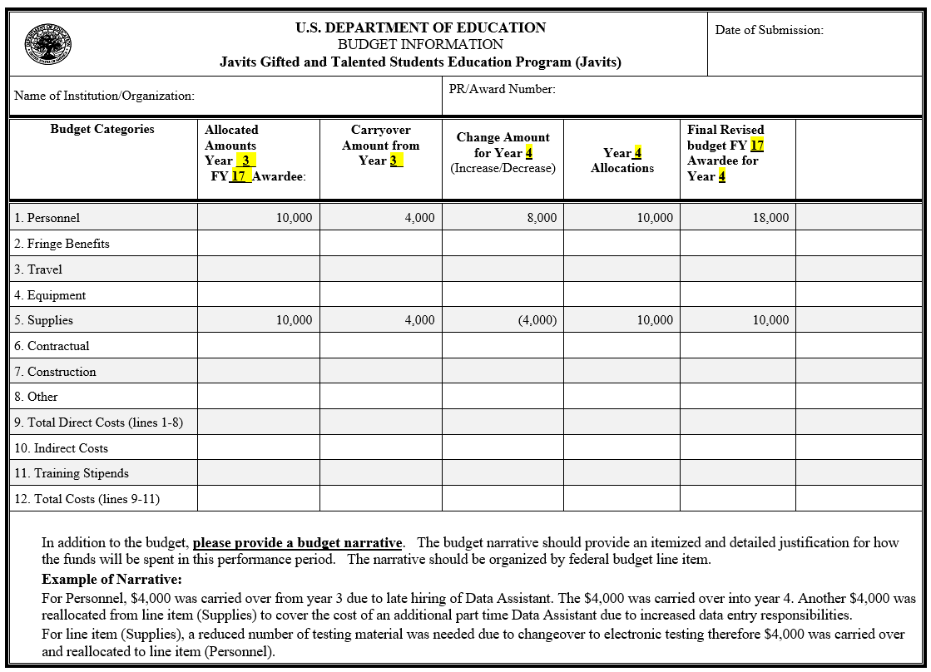
Budget Revisions Form
ED 524b
Notes:
Example of Budget Revisions form for revising budgets that will be used in the next budget year.
See narrative example for explaining all revisions to the budget.

Slide 17
Program Status Chart (Sec C): Other
Key Personnel Changes:
  If any key personnel changed during the reporting period, please describe whether this impacted your ability to achieve your approved project goals and objectives.
  Provide updates to your Program Officer and obtain guidance.
Notes:
Key Personnel Changes – Keep your program officer informed and obtain guidance if necessary.

Slide 18
Final Performance Reports (FPRs)
Final performance reports consist of overall performance measures and completion of the project.
Complete ED 524b Form
Information in Section A of the Project Status Chart must cover the final budget period of the grant. Additional questions for final performance reports covering the entire project period are found in the instructions for Section C of the Project Status Chart.
Manage budget to obtain zero balance of funds at end of grant period.
  Discuss balances with program officer before final year for receiving assistance.
FPRs are due no later than 90 days after grant period ends
Submitted through G5 – Upload documents using the ED 524b form
Notes:
Final Performance Reports are similar to the Annual Performance Reports therefore the completion process is the same. This report will cover the entire project period.
Manage your budget to obtain a zero balance by the end of the grant period
FPRs are due no later than 90 days after the grant ends
Submitted through G5

Slide 19
No Cost Extensions (NCEs)
At the end of a grant period a grantee may have large carryover amounts in which the funds may already be obligated, therefore NCEs are allowable.
  Grantees need more time to complete project goals and objectives with the obligated funds
  Payments to contractors are obligated but not yet received.
Requirements include the following:
  Why an NCE is being requested, specifically outlining the challenges that led to implementation delays and how they will be addressed in the extension period;
  What strategies/programs you will be implementing during the extension period (these cannot be new strategies/programs, but can only be activities in your approved application); and
  Length of NCE. While grantees are allowed up to one year of additional time to complete a project, provided there are no conditions or issues with the administration of the grant or implementation of grant activities, you must provide a rationale for the time period that you need to complete the grant activities.
  Submit a revised budget that display how funds will be reallocated and spent during the NCE timeframe.
  Submit a Performance Progress Report – APR requirements for the performance and budget period; the date for the final APR will be adjusted to the timeframe of the NCE.
Notes:
The last topic is on No Cost Extensions (NCEs). Time may not always allow for obligations to be met therefore NCEs are allowable.
See requirements for requesting NCEs.
- Note that Performance Progress Report will be required since the grant period is being extended and for grantees to meet the annual performance requirements. This will eliminate any gaps in annual reporting.

Slide 20
Reporting Dates and Deadlines
Check-in Calls: Mid-Year Reporting:
FY 19 & FY17 Grantees: March / April 2020
FY 18 Grantee: April / May 2020
Budget Revisions:
FY 19 Grantees: Year 2 Interim budgets – March 16, 2020
FY 18 Grantee: Year 4 budgets – December 30, 2020
FY 17 Grantees: Year 4 budgets – November 30, 2020
Annual Performance Reports (APRs):
FY 19 Grantees: Year 1 Report – December 30, 2020
FY 18 Grantee: Year 3 Report – January 30, 2021
FY 17 Grantees: Year 3 Report – December 30, 2020
Final Performance Reports (FPRs):
No later than 90 days after the end of grant period
Year 2 budgets – November 30, 2020
Notes:
Snapshot of Reporting Dates and Deadlines

Slide 21

Thank you for your joining us today!
Questions?
This presentation will be posted on the Javits Program Webpage under Resources.
Submit further questions to your Javits Program Officer.

Slide 22

Javits Team Contact Information
Michelle Georgia — Group Leader
  Michelle.Georgia@ed.gov / 202-453-5501
M. Jeanette Horner-Smith, Ph.D. — Team Leader
  Mildred.Horner-Smith@ed.gov / 202-453-6661
Gay Ojugbana — Program Officer
  Gay.Ojugbana@ed.gov / 202-260-1461
Charm Smith — Program Officer
  Charm.Smith@ed.gov / 202-205-5724

